Slide 1
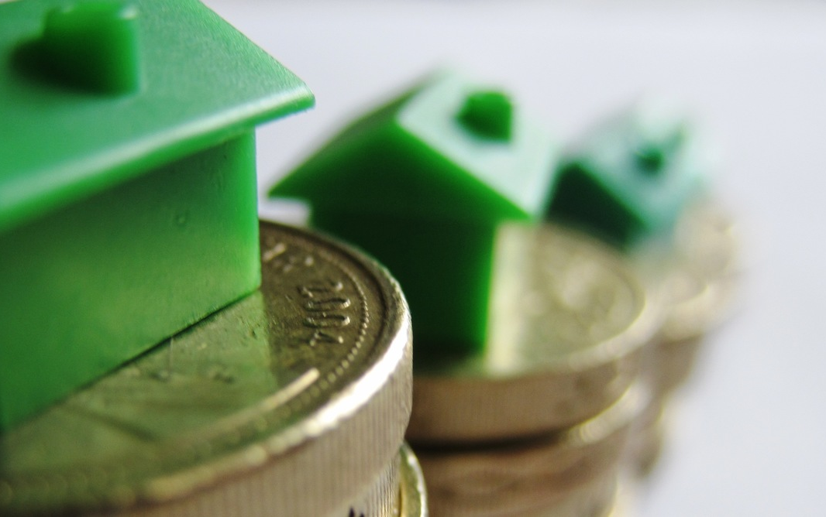

Home Prices
This Photo by Unknown Author is licensed under CC BY-ND

Slide 2
Smart Investments
Investing in the right homes

Slide 3
Smart Investments
Investing in the right homes
Neighborhood

Slide 4
Smart Investments
Investing in the right homes
Neighborhood
Year built

Slide 5
Smart Investments
Investing in the right homes
Neighborhood
Year built
Year remodeled

Slide 6
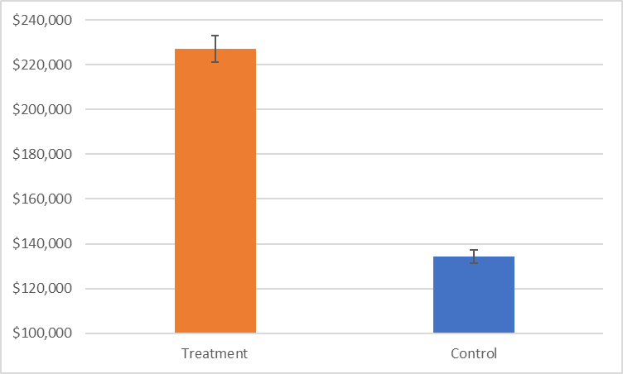
Neighborhood
Significantly higher prices:
College Creek
Somerset
Gilbert
Northridge Heights
Northwest Ames
Sawyer West
Crawford
Northridge
Timberland
Clear Creek
Stone Brook
Bloomington
Veenker

Slide 7
Neighborhood
Significantly higher prices:
$226,967 average

Slide 8
Neighborhood
Significantly higher prices:
$226,967 average
Note: Axis not at 0

Slide 9
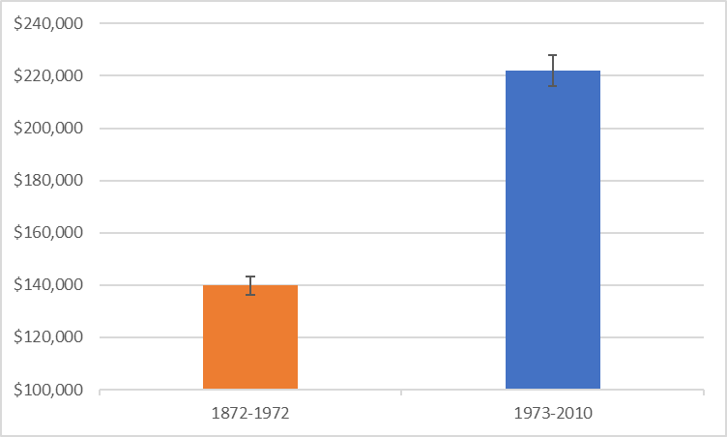
Year Built
Significantly higher prices:
Built after 1972

Slide 10
Year Built
Significantly higher prices:
Built after 1972
$221,967 average

Slide 11
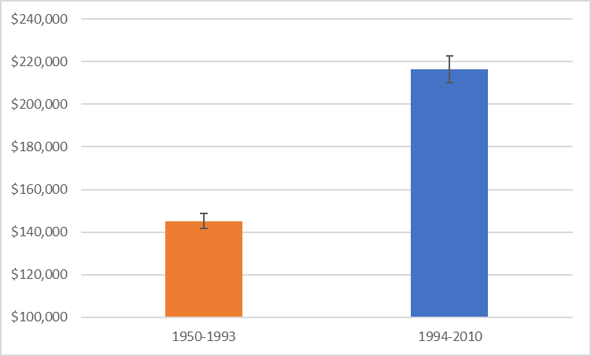
Year Remodeled
Significantly higher prices:
Remodeled after 1993

Slide 12
Year Remodeled
Significantly higher prices:
Remodeled after 1993
$216,437 average

Slide 13
Conclusion
Right homes are:
In 13 neighborhoods
Built after 1972
Remodeled after 1993

Slide 14
Conclusion
Right homes are:
In 13 neighborhoods
Built after 1972
Remodeled after 1994
Better investments

